Slide 1


Data Structures
ETCCDS202
Dr. Aarti
Faculty
School of Engineering & Technology
K.R. Mangalam University
Unit 2 : Linear Data Structures

Slide 2

Unit-2 Linear Data Structures
SESSION 11 Arrays – 1D & 2D
SESSION 12 Static & Dynamic Arrays
SESSION 13 Linked Lists Types
SESSION 14 Linked List Operations
SESSION 15 Stack ADT & Operations
SESSION 16 Stack Applications
SESSION 17 Queue ADT
SESSION 18 Queue Applications
SESSION 19 BFS using Queue
SESSION 20 Revision (Unit–2)
Notes:
New Courses replaced with New Programmes

Slide 3
Static and Dynamic Arrays
Session 12
Introduction to Arrays
Recapitulation: 1-D and 2-D Arrays
Classification of Arrays
Static Arrays
Dynamic Arrays
Advantages and Limitations
Real-World Applications
Practice Questions
Key Takeaways
Quick Quiz
References
Notes:
New Courses replaced with New Programmes

Slide 4
Learning Objectives
After this lecture, students will be able to:
Define static arrays and dynamic arrays
Differentiate between static and dynamic arrays
Write programs using static and dynamic arrays
Decide when to use which type of array
Notes:
New Courses replaced with New Programmes

Slide 5
Recapitulation (Unit-2: 1-D Array)
Arrays: Store elements of the same data type
Elements are stored in contiguous memory locations
Each element is accessed using an index (starts from 0)
Why Arrays are Used?
Random access using index
Simplifies repetitive operations using loops
Notes:
New Courses replaced with New Programmes

Slide 6
Recapitulation (Unit-2: 2-D Array)
1-D Arrays
Store elements in a single row (linear form)
Common operations: Traversal, Sum of elements, Searching elements
Two-Dimensional Arrays (2-D Arrays)
Data stored in rows and columns
Index format: array[row][column]
Notes:
New Courses replaced with New Programmes

Slide 7
Recapitulation
Q1. What is an array?
a) A non-linear data structure b) A collection of elements of different types c) A collection of elements of the same type stored contiguously d) A dynamic data structure
Q2. What is the index of the first element in an array?
a) 1 b) -1 c) 0 d) Depends on compiler
Notes:
New Courses replaced with New Programmes

Slide 8
Recapitulation
Q3. Which of the following is true about arrays?
a) Arrays store elements of different data types b) Arrays grow automatically in size c) Arrays store elements in contiguous memory locations d) Arrays do not support indexing
Q4. How many indices are required to access an element in a 2-D array?
a) One b) Two c) Three d) Depends on data type
Notes:
New Courses replaced with New Programmes

Slide 9
Recapitulation
Quiz (Answers)
Q1: c) A collection of elements of the same type stored contiguously
Q2: c) 0
Q3: c) Arrays store elements in contiguous memory locations
Q4: b) Two
Notes:
New Courses replaced with New Programmes

Slide 10
What is an Array?
An array is a collection of elements of the same data type
Stored in contiguous memory
Accessed using index values
Index starts from 0
Example: int arr[5] = {10, 20, 30, 40, 50};
Notes:
New Courses replaced with New Programmes

Slide 11
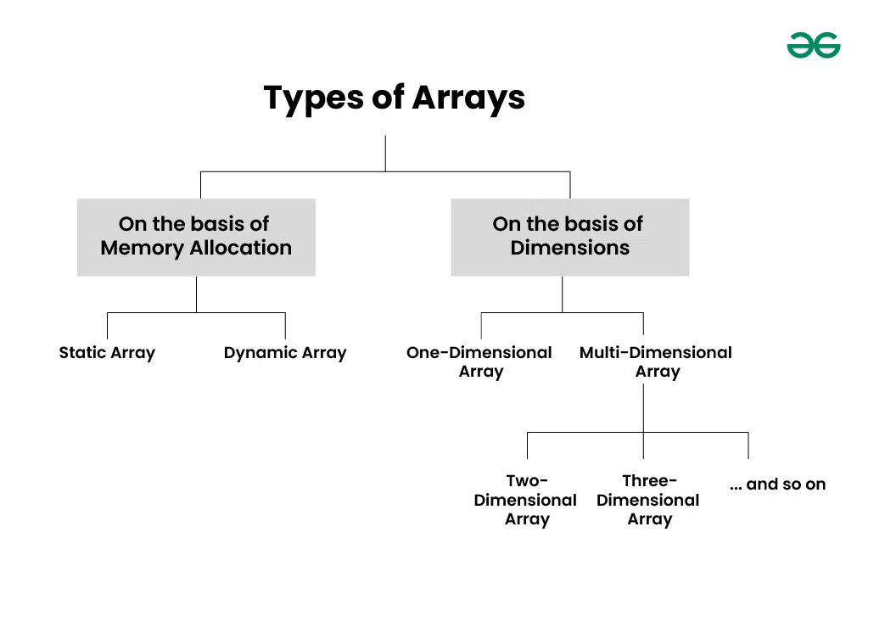
Classification of arrays
Arrays can be classified based on:
Size declaration (Dimensions)
Memory allocation time
Fig.1: Types of Arrays
Notes:
New Courses replaced with New Programmes

Slide 12
Static Arrays
Example: Fixed seating in a classroom
Memory allocated at compile time.
Array is of fixed size.
Size must be known before execution
Size cannot be changed later during program execution
Size in square brackets [ ].
Example:
int arr[5] = {1, 2, 3, 4, 5};
Notes:
New Courses replaced with New Programmes

Slide 13
Static Array – Syntax and Initialization (Python)
 | Method-1 | Method-2
Syntax | arr = [0] * 5 | import array arr = array.array('i', [0, 0, 0, 0, 0])
Initialization | arr = [10, 20, 30, 40, 50] | import array arr = array.array('i', [1, 2, 3, 4, 5])
Explanation | Size is decided at creation Index-based access Size is treated as fixed in logic Python allows resizing, but we do not resize it → behaves like static array | 'i' → integer type All elements must be of the same type
Notes:
New Courses replaced with New Programmes

Slide 14
Example Program (Static Array Simulation in Python)
# Static array simulation in Python
arr = [10, 20, 30, 40, 50] # size fixed at creation
print("Static Array Elements:")
for i in range(5):
print(arr[i])
Output:
20
Key Points:
Size decided at creation
No append or resize operation used
Behaves like a static array conceptually
Notes:
New Courses replaced with New Programmes

Slide 15
Static Array – Memory Allocation
Memory allocated at compile time.
Usually stored in stack memory
Faster access
Limited flexibility
If array size is exceeded → memory wastage or overflow risk
Notes:
New Courses replaced with New Programmes

Slide 16
Static Array – Advantages & Limitations
Advantages:
Simple to declare and use
Fast access
Less overhead
Limitations:
Fixed size
Memory wastage possible
Not suitable when size is unknown
Notes:
New Courses replaced with New Programmes

Slide 17
Check Your Understanding
❓ Can the size of a static array be changed at runtime? ❓ What happens if the array size is exceeded?
Notes:
New Courses replaced with New Programmes

Slide 18
Check Your Understanding (Answers)
❓Can the size of a static array be changed at runtime? No, the size of a static array cannot be changed during runtime.
❓What happens if the array size is exceeded?
It may cause memory overflow or runtime errors, leading to unexpected behavior.
Notes:
New Courses replaced with New Programmes

Slide 19
Dynamic Arrays
Example: Expanding waiting list for admissions
Memory allocated at run time.
Array is not of fixed size.
Specify size during run time.
Stored in heap memory
Size can be modified using memory management functions.
Example:
int* arr = new int[5];
Notes:
New Courses replaced with New Programmes

Slide 20
Dynamic Array – Advantages & Limitations
Advantages:
Flexible size
Efficient memory utilization
Suitable for large data
Limitations:
Slower than static arrays
Memory leaks if not freed
More complex to manage
Notes:
New Courses replaced with New Programmes

Slide 21
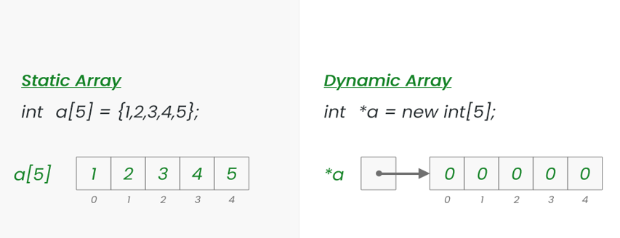
Example of Static and Dynamic Arrays
Fig.2: Example of Static and Dynamic Arrays
Notes:
New Courses replaced with New Programmes

Slide 22
Dynamic Array Using Python List
Syntax
arr = []
Initialization
arr = [10, 20, 30]
Adding Elements (Dynamic Growth)
arr.append(40)
arr.append(50)
Accessing Elements
print(arr[2]) # Output: 30
Notes:
New Courses replaced with New Programmes

Slide 23
Dynamic Array – Example
Example Program
arr = []
for i in range(5):
arr.append(i * 10)
print(arr)
Output:
[0, 10, 20, 30, 40]
Python automatically resizes memory when needed.
Python lists are dynamic arrays by default.
Notes:
New Courses replaced with New Programmes

Slide 24
Comparison: Static vs Dynamic Array in Python
Feature | Static-like Array | Dynamic Array
Size | Fixed logically | Changes at runtime
Structure | List / array | List
Memory | Heap | Heap
Resize | Not allowed | Allowed
Flexibility | Low | High
Code Perspective
Initial size | Fixed | Zero
Resize allowed | No (by logic) | Yes
append() used | Avoided | Used
Flexibility | Low | High
Note: In Python, a dynamic array is implemented using lists, which automatically resize themselves when elements are added or removed during program execution.
Notes:
New Courses replaced with New Programmes

Slide 25
Check Your Understanding
Which Python data structure behaves as a dynamic array?
What happens internally when a list grows beyond capacity?
When to Use Dynamic Arrays?
Notes:
New Courses replaced with New Programmes

Slide 26
Check Your Understanding (Answers)
1. Python list behaves as a dynamic array.
2. Python allocates a larger memory block, copies existing elements to it, and updates the list reference, enabling amortized O(1) growth.
3. Dynamic Arrays are used:
When input size is unknown
When frequent insertions are required
When memory flexibility is needed
Notes:
New Courses replaced with New Programmes

Slide 27
Dynamic Array (Resizable) in Python
# Dynamic array in Python
arr = [] # empty list (dynamic array)
for i in range(5):
arr.append(i * 10)
print("Dynamic Array Elements:")
for i in range(len(arr)):
print(arr[i])
Key Points:
Size changes at runtime
Python lists are dynamic arrays by default.
Notes:
New Courses replaced with New Programmes

Slide 28
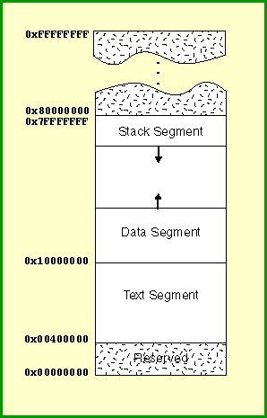
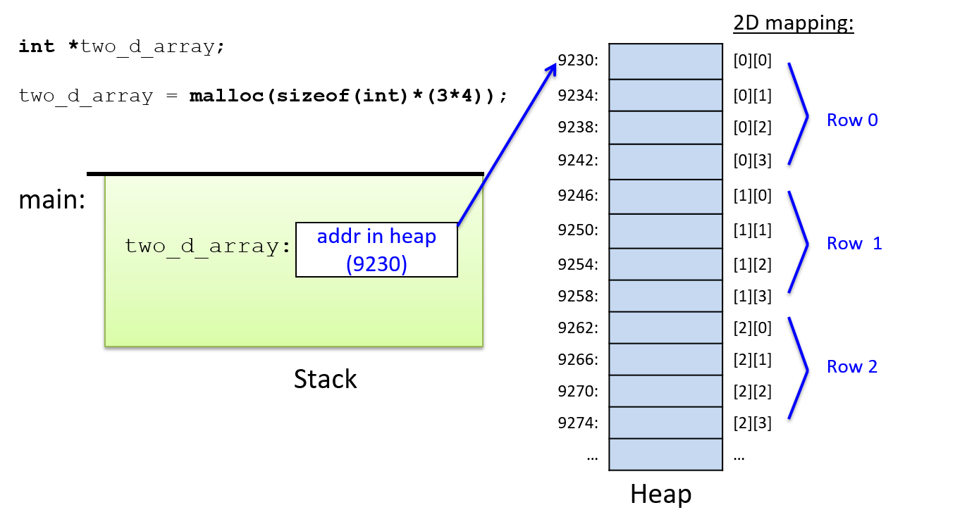
Visual Memory Representation
Fig.3 (a): Dynamic Arrays
Fig.3 (b): Static Arrays
Fig.3: Visual Memory Representation of Static and Dynamic Arrays
Notes:
New Courses replaced with New Programmes

Slide 29
Practice Questions
Task:
Declare a static array of size 5
Convert the same program using a dynamic array
Identify the memory location used in both cases
Exercise:
Write a program to:
Accept array size from the user
Allocate memory dynamically
Store and display elements
Notes:
New Courses replaced with New Programmes

Slide 30
Practice Questions- Task – Answer in Python
Declare a Static Array of Size 5 (Simulated in Python)
# Static array simulation in Python
arr = [10, 20, 30, 40, 50] # size fixed at creation
print(arr)
Explanation:
Python does not support true static arrays, so a fixed-size list is used and not resized, simulating static array behavior.
Notes:
New Courses replaced with New Programmes

Slide 31
Practice Questions- Task – Answer in Python
Convert the Same Program Using a Dynamic Array
arr = []
for i in range(5):
arr.append((i + 1) * 10)
print(arr)
Memory Location Used
Static array (simulated list): Heap memory
Dynamic array (list): Heap memory
Note: In Python, all lists are stored in heap memory.
Notes:
New Courses replaced with New Programmes

Slide 32
Practice Questions- Exercise – Answer in Python
# Dynamic array with user input program in Python
n = int(input("Enter the size of the array: "))
arr = []
# Store elements
for i in range(n):
element = int(input(f"Enter element {i+1}: "))
arr.append(element)
# Display elements
print("Array elements are:")
for i in range(len(arr)):
print(arr[i])
Notes:
New Courses replaced with New Programmes

Slide 33
Static Array Applications
Used to store fixed exam marks when the number of subjects is known.
Used to represent days of the week or months of the year with a fixed size.
Used in game boards like chess or tic-tac-toe, where the board size is constant.
Used in embedded systems for fixed sensor readings due to limited memory.
Notes:
New Courses replaced with New Programmes

Slide 34
Dynamic Array Applications
Used in shopping carts where items can be added or removed dynamically.
Used in social media feeds where posts load and grow at runtime.
Used in student registration systems where the number of students is not fixed.
Used in image and video processing where data size varies dynamically.
Notes:
New Courses replaced with New Programmes

Slide 35
Key Takeaways
Static arrays are simple but rigid
Dynamic arrays are flexible but complex
Memory management is crucial in dynamic arrays
Choose wisely based on data size predictability
Notes:
New Courses replaced with New Programmes

Slide 36
Quick Quiz
Which memory is used by dynamic arrays?
Which array type is faster?
When should static arrays be preferred?
Notes:
New Courses replaced with New Programmes

Slide 37
Quick Quiz (Answers)
Which memory is used by dynamic arrays?
Dynamic arrays use heap memory.
Which array type is faster?
Static arrays are faster due to fixed size and compile-time memory allocation.
When should static arrays be preferred?
Static arrays should be preferred when the data size is fixed and known in advance.
Notes:
New Courses replaced with New Programmes

Slide 38
Quick Quiz
Fill in the Blanks
The memory used by static arrays is ________.
The Python data structure that behaves as a dynamic array is ________.
Dynamic arrays are stored in ________ memory.
Static arrays have a ________ size decided before execution.
The append() method is used to add elements in a ________ array in Python.
Notes:
New Courses replaced with New Programmes

Slide 39
Quick Quiz (Answers)
Stack
List
Heap
Fixed
Dynamic
Notes:
New Courses replaced with New Programmes

Slide 40
References
Textbooks
Cormen, T. H., Leiserson, C. E., Rivest, R. L., & Stein, C., Introduction to Algorithms, MIT Press.
Lipschutz, S., Schaum’s Outline of Data Structures with C++, McGraw-Hill Education.
Reference Books
Weiss, M. A., Data Structures and Algorithm Analysis in C++, 5th Edition, Pearson Education.
Skiena, S. S., The Algorithm Design Manual, 3rd Edition, Springer.
Online Resources
GeeksforGeeks – Arrays in Data Structures https://www.geeksforgeeks.org/array-data-structure/
TutorialsPoint – Data Structures: Arrays https://www.tutorialspoint.com/data_structures_algorithms/array_data_structure.htm
MIT OpenCourseWare – Introduction to Algorithms https://ocw.mit.edu
Programiz – Python Lists (Dynamic Arrays) https://www.programiz.com/python-programming/list
Notes:
New Courses replaced with New Programmes

Slide 41
THANK YOU

